Slide 1
MicroArray gene expression project(project 3 )
Bioinformatics course
Dr.Taysir Hassan

Slide 2
Team members:
Aliaa Yaseen AbdelElkareem
Magdoleen Magdy Zaka
Ghada Atef Mohammed
Ghada Magdy Sayed
Fatma Elzahraa Shehata

Slide 3
Alterations in circulating monocytes predict COVID-19 severity and include chromatin modification still detectable six months after recovery

Slide 4
Overview about our project
An early analysis of circulating monocytes may be critical for predicting COVID-19 course and its sequelae. In 131 untreated, acute COVID-19 patients at emergency room (ER) arrival, monocytes showed decreased surface molecules expression, including HLA-DR, in association to an inflammatory cytokine status and limited anti-SARS-CoV-2-specific T cell response. These alterations were mostly normalized in post-COVID-19 patients, 6 months after discharge. Acute COVID-19 monocytes transcriptome showed upregulation of anti-inflammatory, tissue repair genes such as BCL6, AREG and IL-10 and increased accessibility of chromatin. Some of these transcriptomic and epigenetic features still remained in post-COVID-19 monocytes. Importantly, a poorer expression of surface markers and low IRF1 gene transcription in circulating monocytes at ER defined a COVID-19 patients group with impaired SARS-CoV-2-specific T cell response and increased risk of requiring intensive care or dying. An early analysis of monocytes may be useful for COVID-19 patients stratification and to designing innate immunity-focused therapies.

Slide 5
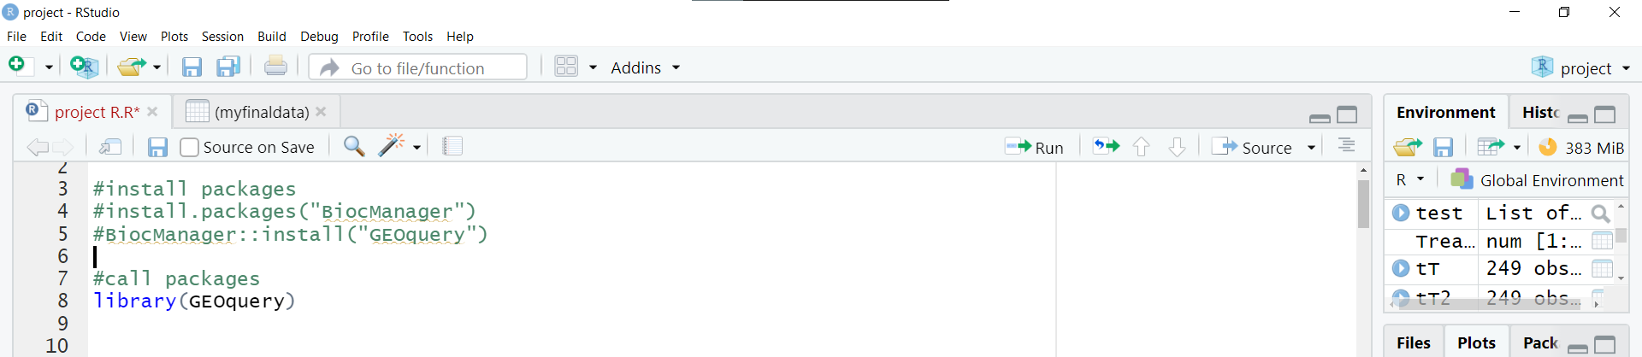
First install Packages :
We use package BiocManager And GEOquery

Slide 6
To get data online from NCBI
We search in gene expression omnibus and GEOdatabase.
In line 12 , we use getGEO by put accession number of our data .
We get 1 file to run data.
In line 14 , we get data online by use exprs.
In line 15 , choose 20 gene from our data

Slide 7
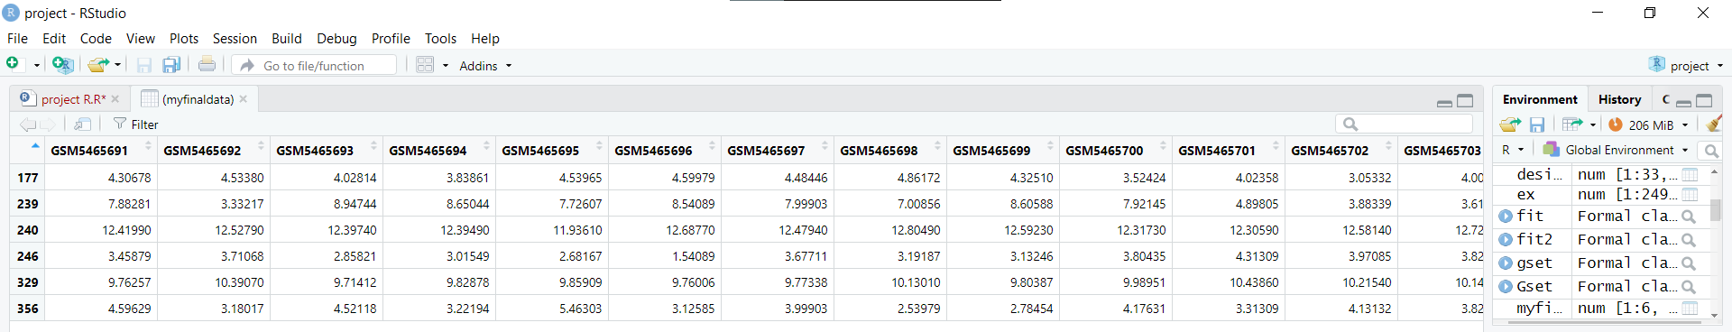
Our 20 gene with samples and features :

Slide 8
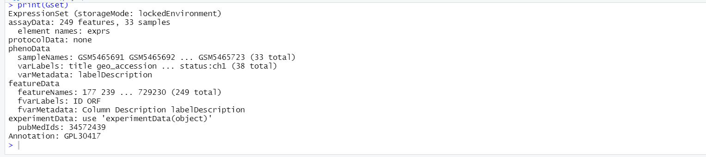
Output of print Gset

Slide 9
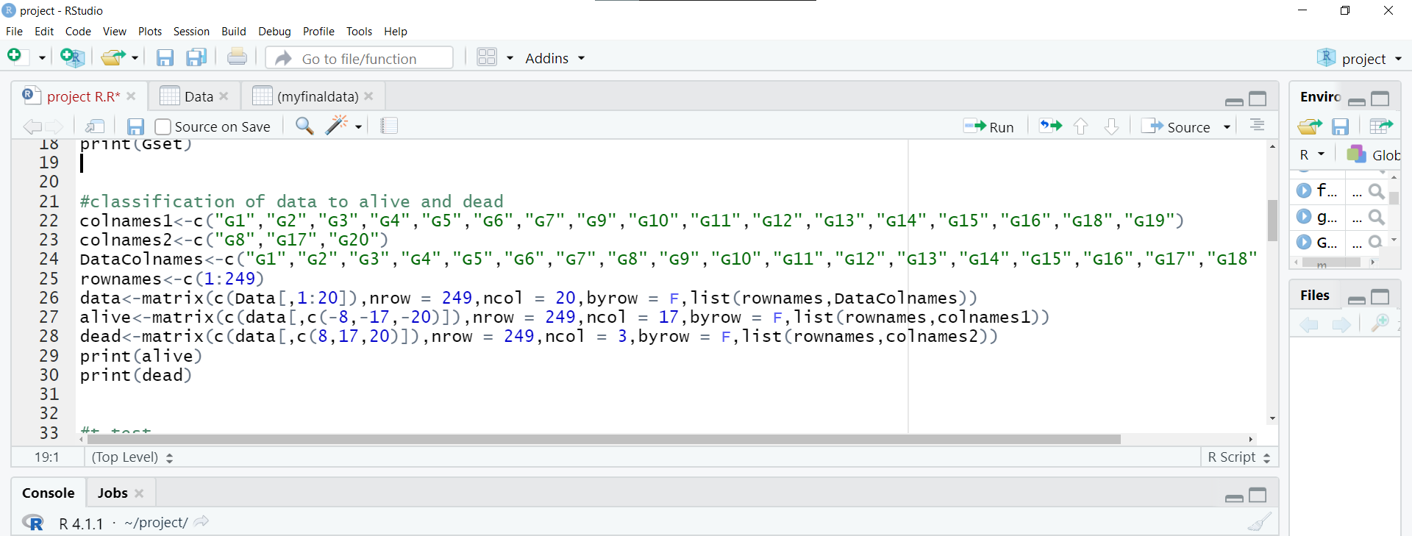
We classify our data to two statues (Dead,Alive).
In line 25 , we store all features from 1 to 249 in “rownames” variable.
There are 3 dead statues in our samples.
There are 17 alive statues in our samples.

Slide 10
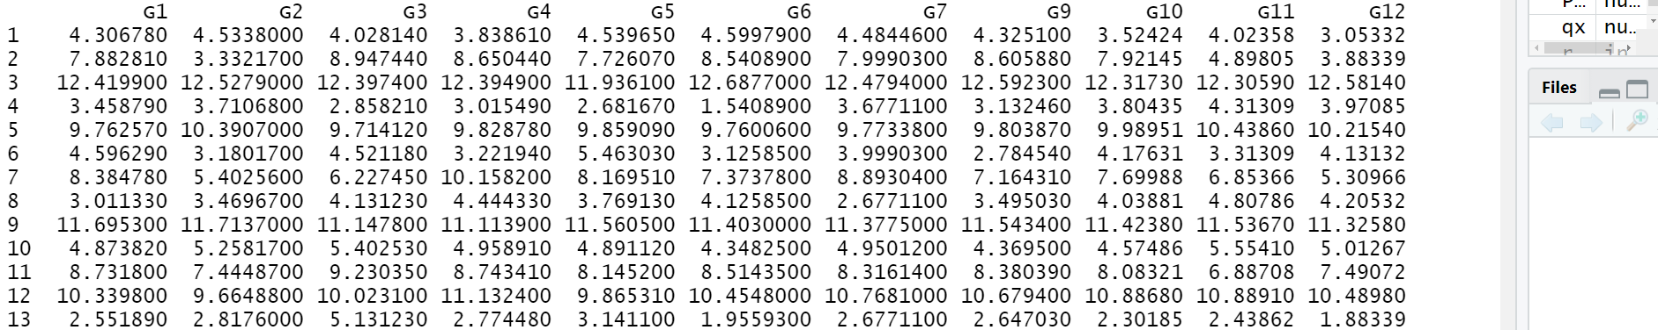
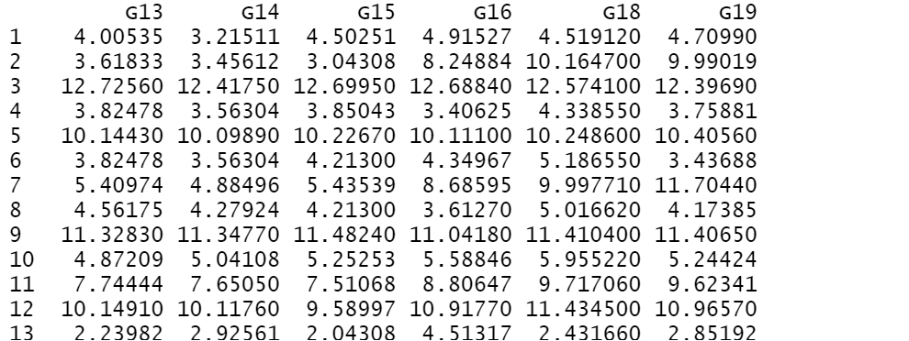
Output of alive status

Slide 11
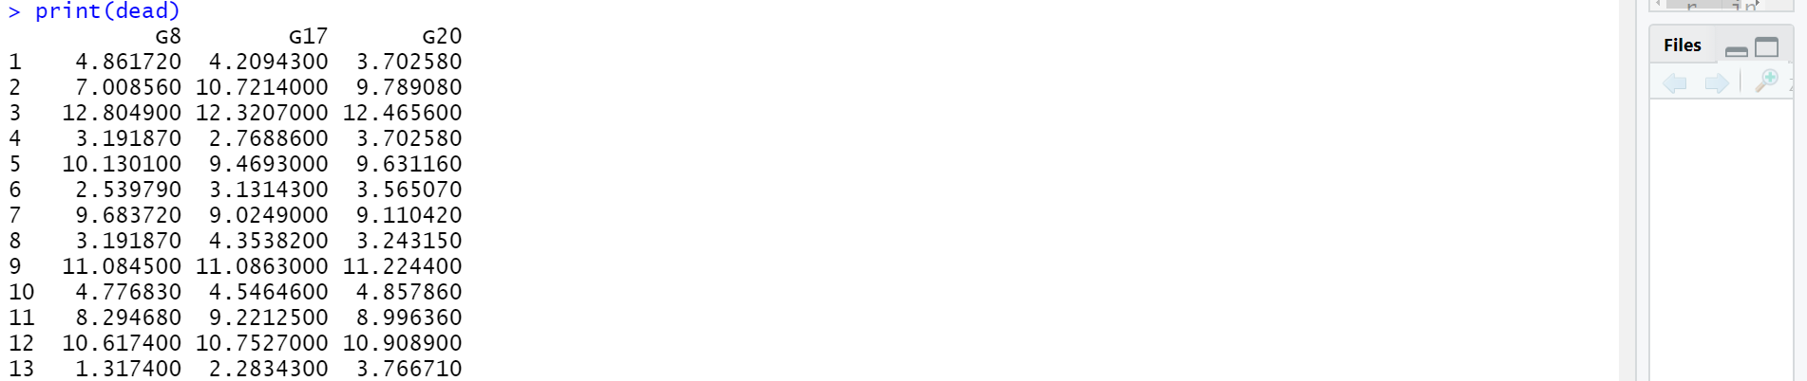
Output of dead status

Slide 12
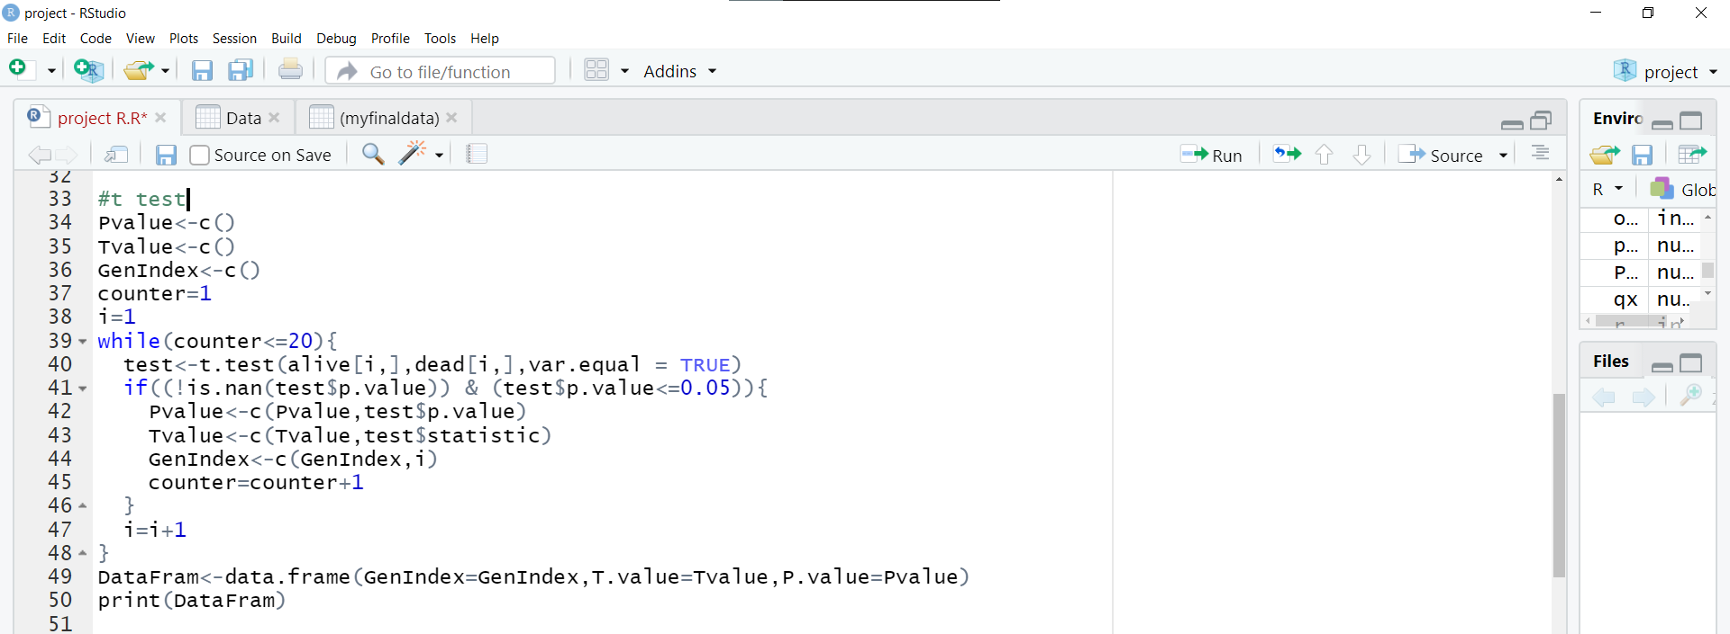
We apply independent T test on the data .

Slide 13
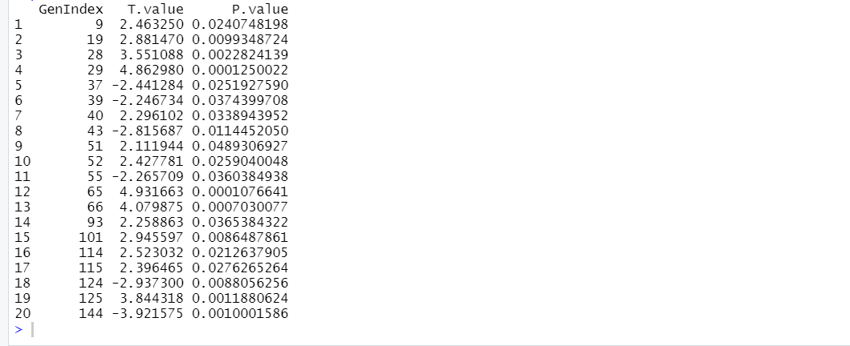
Output of T-test

Slide 14
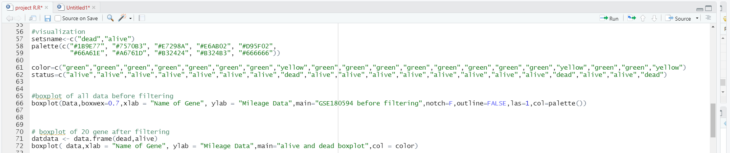
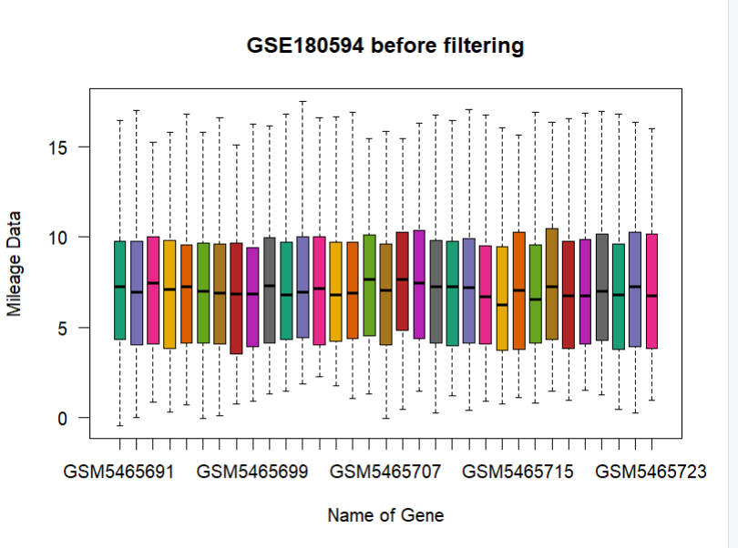
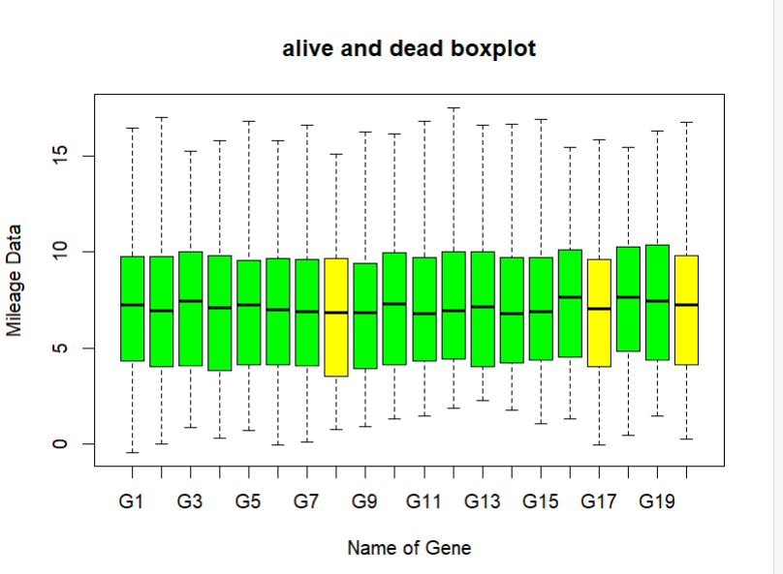
Boxplot of all data before and after filtering
before
after

Slide 15
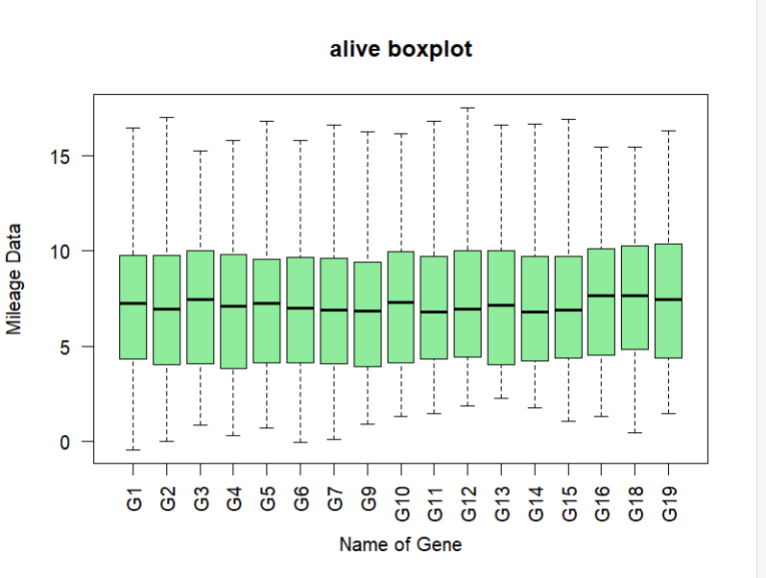
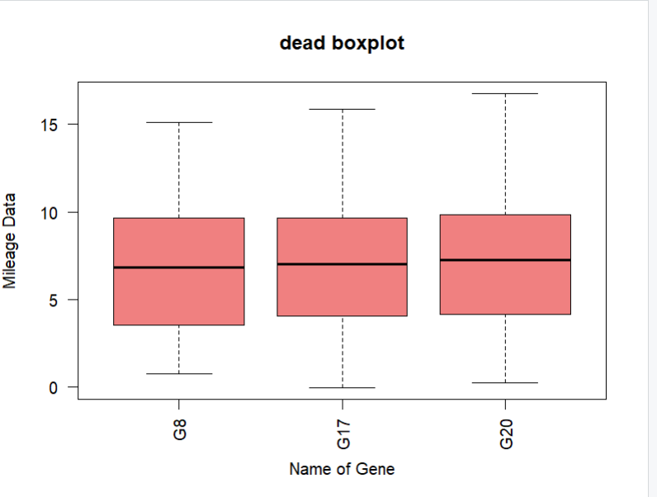
Boxplot of alive and dead status
dead
alive

Slide 16
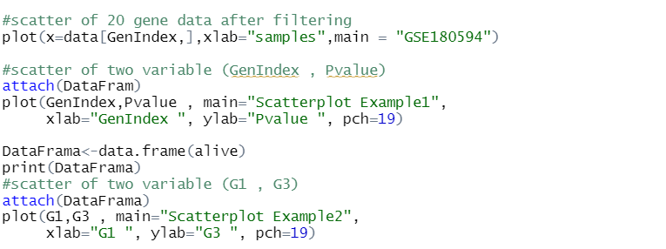
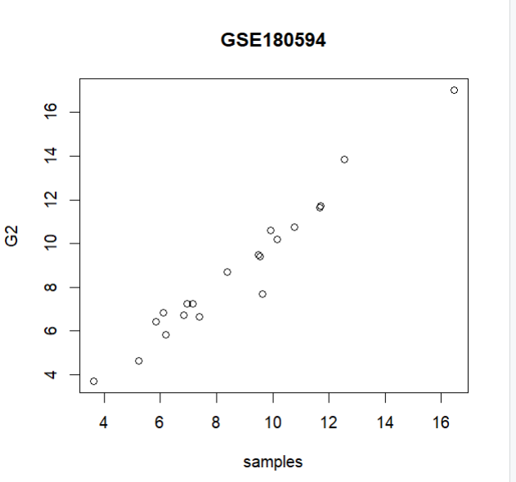
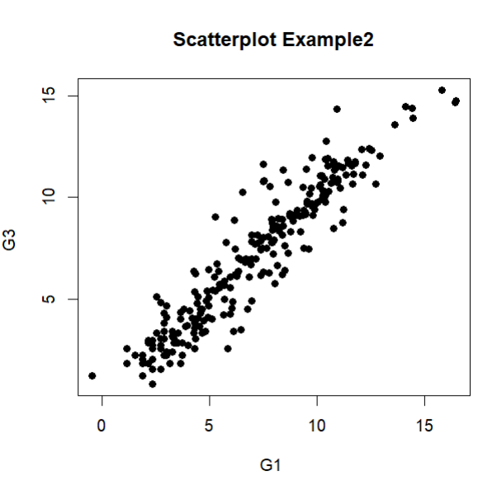
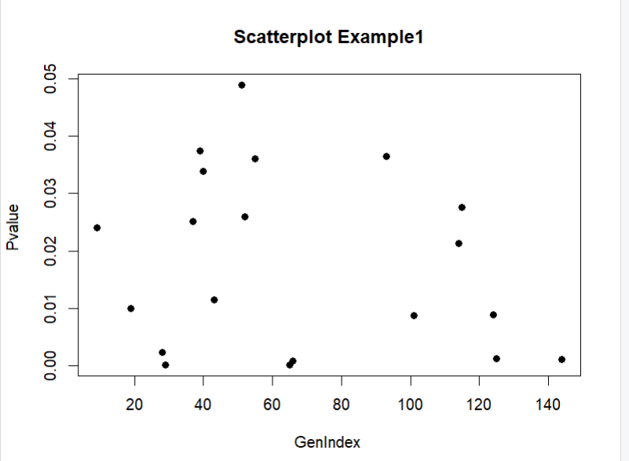
Scatter of 20 gene and two different examples
Scatter of 20 gene
Example 1(GenIndex,P Value)
Example 2(G1,G3)

Slide 17
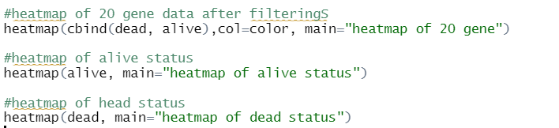
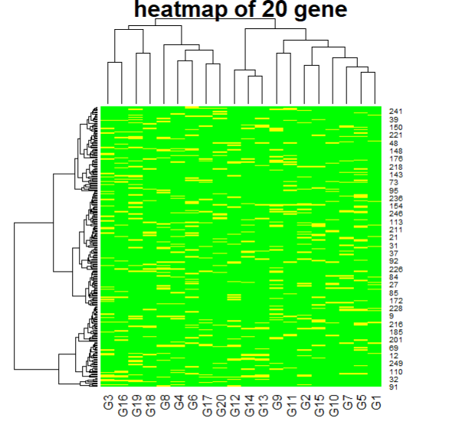
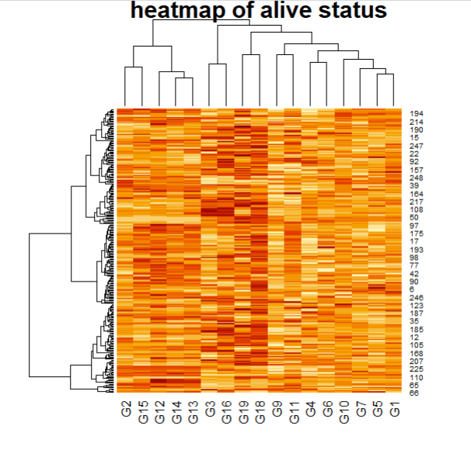
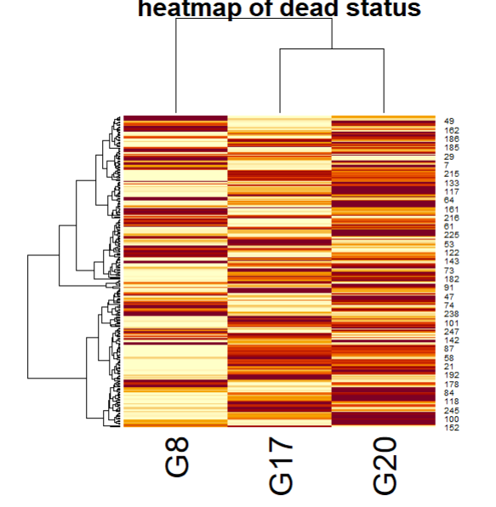
Heatmap of 20 gene and heatmap of alive and dead status
Heatmap of 20 gene
Heatmap of alive status
Heatmap of dead status

Slide 18
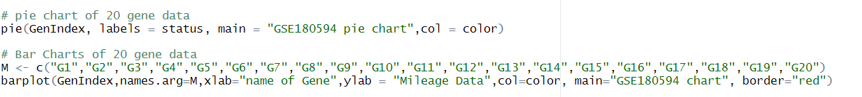
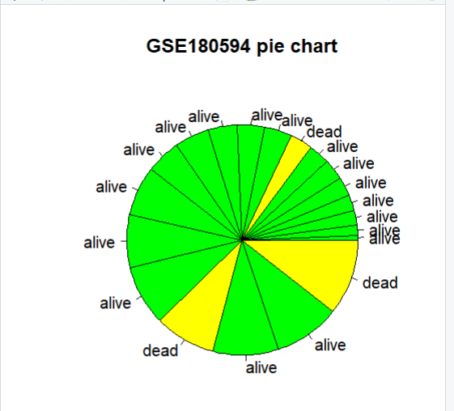
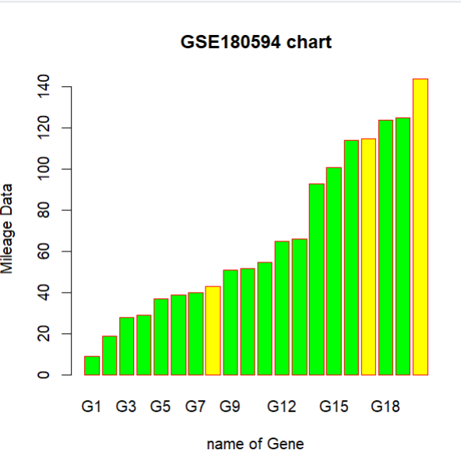
Pie chart of 20 gene
Bar chart of 20 gene

Slide 19
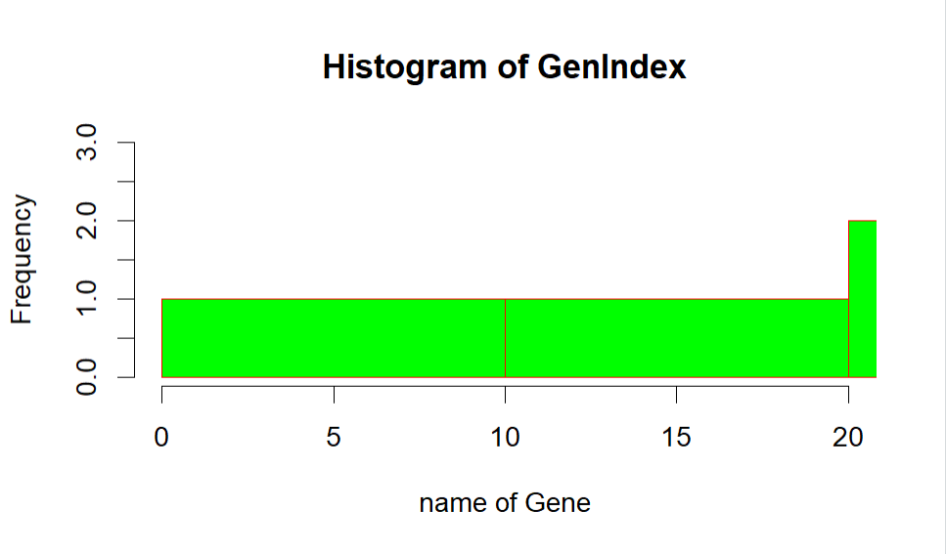
Histogram of 20 gene data

Slide 20
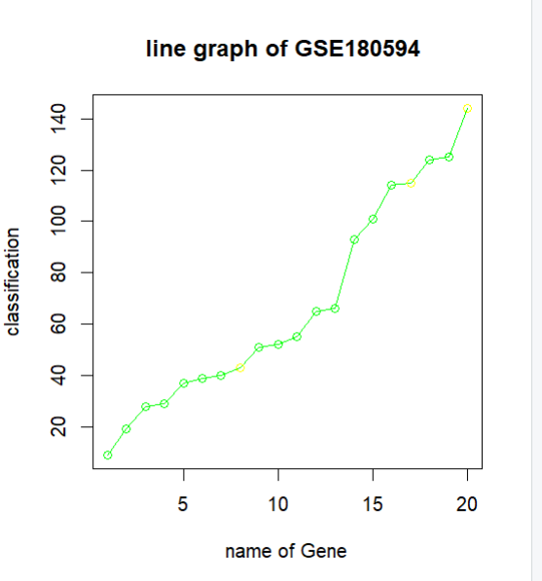
Line graph of data

Slide 21
Thank you

